Slide 1

Notes Junction
A Web App for Amazing e-learning Experience

Slide 2

Team Members :
Ayush Ranjan ( 1806205 )
Raj Priyam ( 1806406 )
Anwesha Dey ( 1806198 )
Arishmita Roy ( 1806199 )

Slide 3

Problem Statement
Transforming learning into Amazing e-learning Experiences.
Lack Of Learner Motivation And Engagement.
Staying Up-To-Date With Modern Tech.
Designing e-learning Courses For Different Generations
Measurable learning outcomes
Adaptive learner models to accommodate different learner needs.

Slide 4

Possible Solution
The idea is to design a web application that will have a lot of e-learning courses generated by various instructors and the learners can subscribe to those courses. It will consist of text notes, video lectures , quizzes specific to lectures and regular tests , a leaderboard and a final assessment test with a certificate to learners for completing the course within a deadline .

Slide 5

Working Prototype

Slide 6
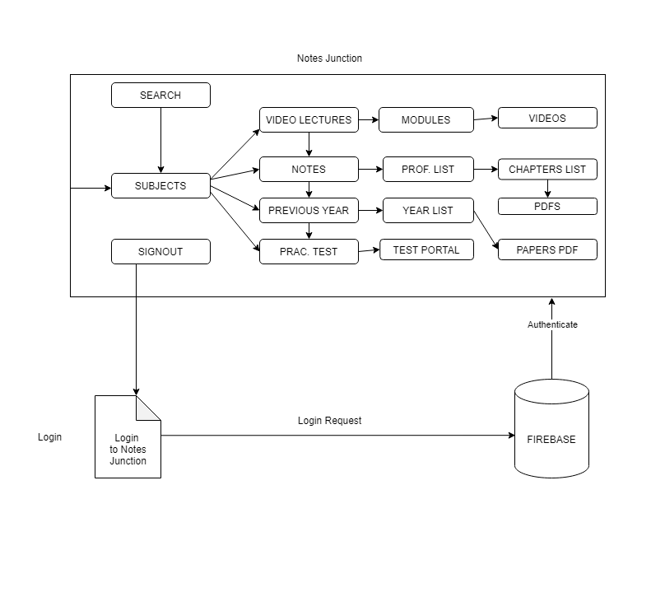
Block Diagram

Slide 7

Tools and Techniques used :
HTML-5
CSS-3
Bootstrap-5
Javascript
Jquery
Firebase

Slide 8
THANK YOU

